Slide 1
TB IO8 (TB004502) – Reverse polarity connector J32
ANBG-NV Adapter QA Team
October 29, 2026

Slide 2

Discipline 1
Form a Team
Discipline 2
Describe the Issue & Status
Discipline 3
Containment Action
Discipline 4
Describe the Root Cause
Discipline 5
Corrective Action
Discipline 6
Verify Effectiveness of Actions
Discipline 7
Preventive Action Plan
Discipline 8
Congratulate Your Team

Slide 3
Discipline 1
D1
Form a Team
D2
D3
D4
D5
D6
D7
D8
TEAM | NAME | CONTACT
Ops Head | Ming-Jie | ming-jie.fu@fii-foxconn.com
ME Manager | Guo Bin | bin.b.guo@fii-foxconn.com
ME Leader | Feliz | feliz.jy.zhang@fii-foxconn.com
ME AOI Leader | Sky | sky.dq.liu@fii-foxconn.com
QA Manager | Joshua He | joshua.jy.he@fii-foxconn.com
PQE Leader | Harry Chen | Harry.ws.chen@fii-foxconn.com
PQE Member | Shan Li | Ting-shan.li@fii-foxconn.com
PQA Leader | Andrew | andrew.hs.ding@fii-foxconn.com
PD Manager | Xin-Hong | xin.hong.zhang@fii-foxconn.com
PD Leader | Wen-Xin | wen-xin.chen@fii-foxconn.com
PE Manager | Mark | mark.ds.ruan@fii-foxconn.com
PE Leader | Tom | tom.ph.fan@fii-foxconn.com

Slide 4
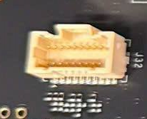
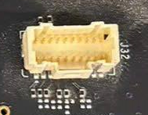
Discipline 2
Describe the Issue & Status
D1
D2
D3
D4
D5
D6
D7
D8
What
When
Where
Detect location: F06-2F- B34G (TE ware house)
P/N: TB IO8 (TB004502) –
SMT line: F06-1F-Line 19 (First MP/Bot side)
Reverse polarity connector J32
MO: 218452, MO Q’ty: 508 pcs
Issue finding time: 2026/10/28 10:51
TB IO8 (TB004502) – Reverse polarity connector J32
Who
TE Quan
Why
N/A
How many
Total DRF: 100% (508 pcs)
NG image
OK image

Slide 5
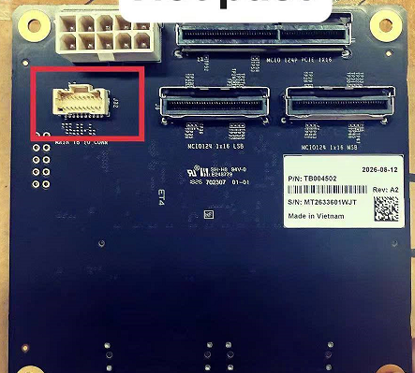
Discipline 2
Describe the Issue & Status
D1
D2
D3
D4
D5
D6
D7
D8
On 2026 Oct 28th 10:51 TE leader Hoang Van Quan assembly test board for the IO8 project and detected a reverse polarity issue at J32.
DRF: 100% (508 pcs)
MO: 218452, MO Q’ty: 508 pcs
Check this MO information:
Product run first time running a production line at SMT F06-1F-Line 19 (First MP/Bot side)
SMT time: 2026-08-07
Material PN: CON001653, Vendor: AMPHENOL.
NG image
OK image

Slide 6
Discipline 3
Containment Action
D3
D4
D5
D6
D7
D8
D1
D2
Conduct sorting at TE B34G WH found 100% NG (508 pcs). TE Quan, Done, 10/28.
Immediately stop line 19 and another line to check all material, no reverse polarity was found. SMT HeBin, Done, 10/28.
Conduct to check AOI image & alarm with another MO for this PN no reverse polarity was found. ME, Thuan, 10/28

Slide 7
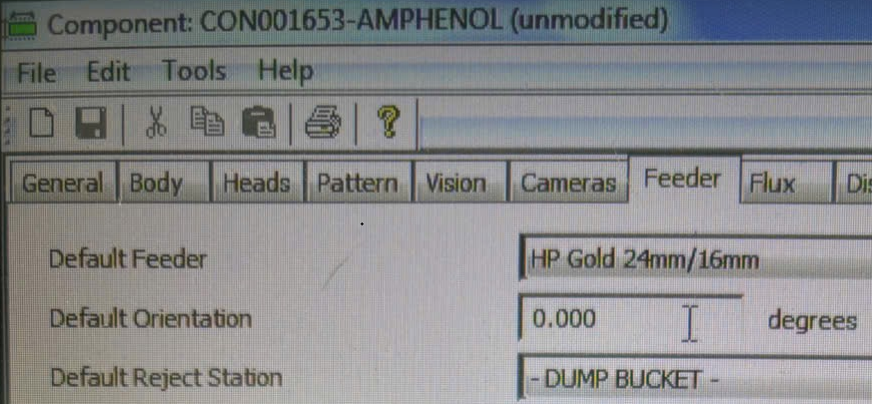
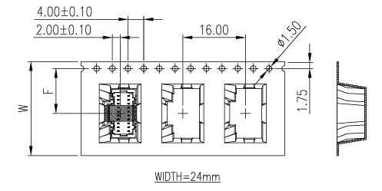
Discipline 4
Describe the Root Cause
D4
D5
D6
D7
D8
D1
D2
D3
Root cause:
Why J32 wrong polarity?
Check program set up and actual PN not map library
Program set up library polarity is 0°
Actual PN polarity is 180°
Why library with actual PN not map?
MO 119352 use MFR Amphenol polarity is DOWN (180°)
Check program from production NPI (Jan-2025) to MP (Apr-2026) only use MFR Molex, so program define library by Molex polarity is UP (0°)
Program set up Molex
Polarity is UP (0°)
Amphenol (G846A202100C1HR-NC): Actual polarity is DOWN(180°)

Slide 8
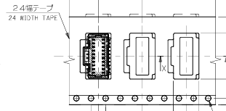
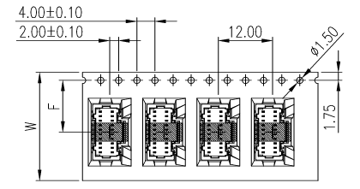
Discipline 4
Describe the Root Cause
D4
D5
D6
D7
D8
D1
D2
D3
Root cause:
Why Molex and Amphenol have different polarity?
Molex: polarity is UP (0°)
Amphenol: polarity type 1 is DOWN (180°) and type 2 is UP (0°)
Type 1
DOWN (180°)
Type 2
UP (0°)
Molex
Polarity is UP (0°)
Amphenol (G846A202100C1HR-NC):

Slide 9
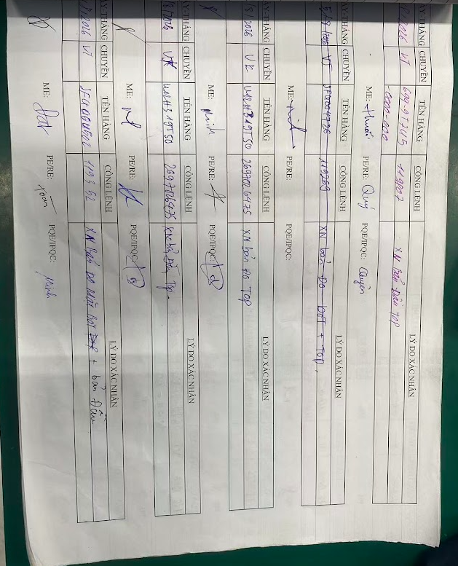
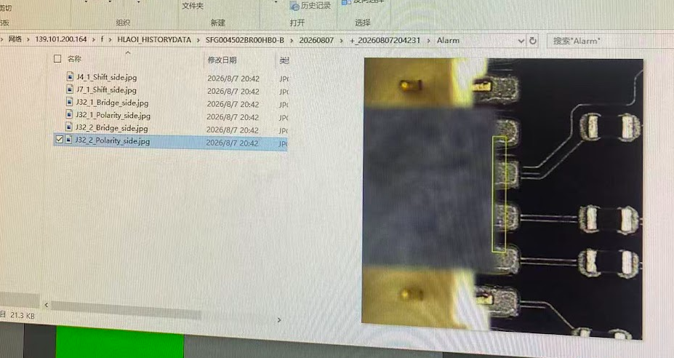
Discipline 4
Describe the Root Cause
D4
D5
D6
D7
D8
D1
D2
D3
Root cause:
Escape cause:
Reverse polarity issue from FAI but CFT (PE/QA/ME) didn’t detect this issue
AOI cover this issue but OP miss check, beside AOI machine not setting auto lock if detect 5 pcs consecutive reverse
AOI data
FAI record

Slide 10
Discipline 5
Corrective Action Plan
D2
D4
D5
D6
D7
D8
D1
D3
Add all part control MFR. Owner/ ME. Ying – Done
Feedback SQE to confirm with Amphenol only ship Type 2 for Foxconn. Owner/ SQE. Bin
AOI setting auto lock if detect 5 pcs reverse consecutive (Done)

Slide 11
Discipline 6
Verify Effectiveness of Actions
D5
D1
D2
D3
D4
D5
D6
D7
D8
D1
D2
D3
D4
D6
D7
D8

Slide 12
Discipline 7
Preventive Action Plan
D1
D2
D3
D4
D5
D6
D7
D8

Slide 13
Discipline 8
Congratulate Your Team
D5
D6
D7
D8
D1
D2
D3
D4
Thank you!!!

Slide 14
Share · Collaborate · Thrive

